Slide 1
Project 2: Option Pricing
This presentation is about how to price stock options using two methods: the Black-Scholes formula and a binomial model. In this presentation we also look into Option Greeks, which are essential for understanding how options react to changes in the market. By analyzing these Greeks, we can assess risks and potential rewards of option positions. The presentation concludes with methods to create delta-neutral portfolios and find implied volatility.
Submitted by
Jamisetti Venkata Sai Kalyan Aashish - M22AI561 Krishna Kumari Ravuri - M22AI567 Chaitrashree C - M22AI539 Bharathi Sontem - M22AI536 Rakesh Reddy Kadapala - M22AI608

Slide 2

Introduction
To design an investment strategy in creating a delta neutral portfolio in a volatile market, we collected historical data of stock and implemented it in Python.
We have calculated the Derivative price by using two approaches:
Binomial model: 1 step binomial model assumes that the price of the underlying asset can fluctuate by a specific factor over a single time step, which simplifies the pricing of options. In The project we Implement 1-step Binomial model and also increase the number of Steps and check for multiple step Binomial Model
Black Scholes Formula It takes into account factors such as the current stock price, strike price, time to expiration, risk-free interest rate, and volatility of the underlying asset. By providing a closed-form solution, the Black-Scholes Formula offers an efficient and precise method for valuing options. By providing a closed-form solution, the Black-Scholes Formula offers an efficient and precise method for valuing options.
In our project, we employ the Black-Scholes Formula to calculate option prices and compare its results with those obtained from the binomial model to validate pricing accuracy and consistency.

Slide 3
Description of selected stock
Company Name | Industry | Brief Description
Apple Inc. (AAPL) | Technology | Apple Inc. is a multinational technology company known for designing, manufacturing, and selling consumer electronics, software, and online services..
Why did we choose Apple stock ?
1. Liquidity: AAPL stock is highly liquid, meaning there are usually many buyers and sellers in the market at any given time.
2. Volatility: AAPL stock tends to exhibit significant price movements, especially around key events such as product launches, earnings reports, and market developments.
3. Diversification: Apple has a sizable global presence and a solid financial position in the International Market and are widely owned by both retail and institutional investors.

Slide 4
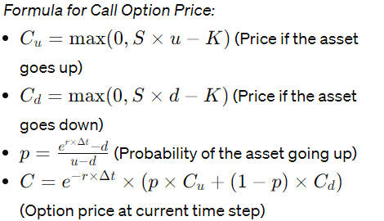
Derivative price by using two approaches:
Binomial Model: The Binomial model is a discrete-time, discrete-state model used for pricing options. It assumes that the price of the underlying asset can change by a specific factor over a single time step, allowing for the calculation of option prices at each step leading to the expiration date.

Slide 5


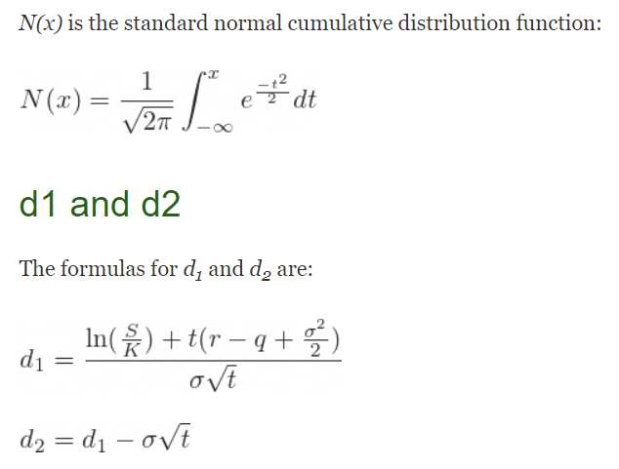
Derivative price by using two approaches:
Black-Scholes Formula: The Black-Scholes formula is a mathematical model used for pricing European-style options. It is based on the assumption of continuous trading and follows a geometric Brownian motion process for the underlying asset's price. The formula takes into account factors such as the current stock price , strike price , time to expiration, risk-free interest rate , and volatility is equal of the underlying asset.

Slide 6
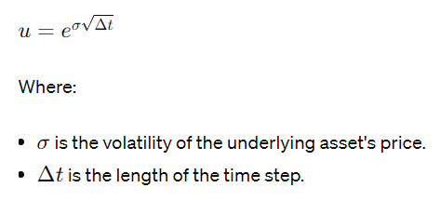
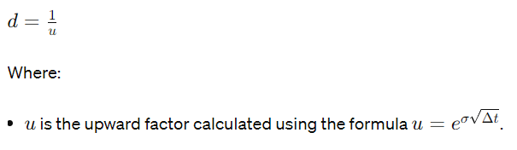
One-Step Binomial Model for Option Pricing
The one-step binomial model assumes that the price of the underlying asset can fluctuate by a specific factor over a single time step, which simplifies the pricing of options.
Step1- Computing dT(Time for one Step)-dt=T/number of steps
Step2-On Basis of the market sentiment We Calculate the upward factor or downward factor

Slide 7
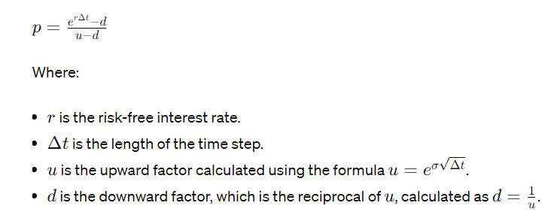
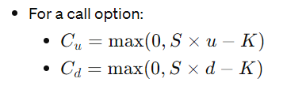
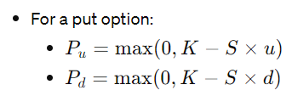
One-Step Binomial Model for Option Pricing
Step 3- We have compute Risk Neutral probability
Finally, We compute the option Price

Slide 8
One-Step Binomial Model for Option Pricing
The computed value of option price when call option is considered: Option Price (One-Step Binomial Model): 27.30883031423434
The computed value of option price when put option is considered:
Put Option Price (One-Step Binomial Model): 7.3838

Slide 9
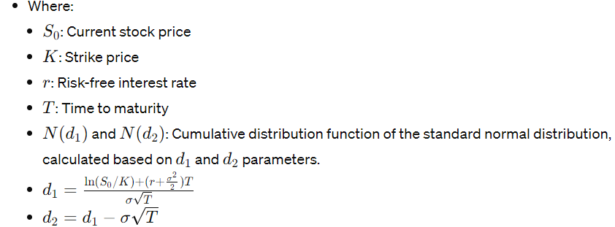
Option Pricing with Black-Scholes Formula
Black-Scholes Formula: The Black-Scholes formula is a mathematical model used for pricing European-style options. It is based on the assumption of continuous trading and follows a geometric Brownian motion process for the underlying asset's price. The formula takes into account factors such as the current stock price is equal to 172, strike price is equal 160 , time to expiration is equal to 1 year, risk-free interest rate is equal to 0.0462, and volatility is equal 0.1959 of the underlying asset.

Slide 10
Option Pricing with Black-Scholes Formula
As we Calculate the call option price and put option price we obtain
Call Option Price (Black-Scholes Formula): : 25.059
Put Option Price (Black-Scholes Formula): 5.1336

Slide 11
Convergence of option prices as the number of steps in the binomial model increases.
As per the Binomial Model we can observe that by increasing the number of steps we converge towards the option prices calculated by Black-Scholes
Call Option Price (One-Step Binomial Model): 27.30883031423434
Put Option Price (One-Step Binomial Model): 7.3838
Call Option Price (Black-Scholes Formula): : 25.059
Put Option Price (Black-Scholes Formula): 5.1336

Slide 12
Convergence Analysis: Binomial Model vs. Black-Scholes Formula
For the Call Option As the number of step Increased
Call Option Price (Binomial Model with 10 steps): 25.295 Call Option Price (Binomial Model with 50 steps): 25.101 Call Option Price (Binomial Model with 100 steps): 25.043 Call Option Price (Binomial Model with 500 steps): 25.063 Call Option Price (Binomial Model with 1000 steps): 25.059 Put Option Price (Binomial Model with 10 steps): 5.3695 Put Option Price (Binomial Model with 50 steps): 5.1754 Put Option Price (Binomial Model with 100 steps): 5.1171 Put Option Price (Binomial Model with 500 steps): 5.1376 Put Option Price (Binomial Model with 1000 steps): 5.1336
For the Put Option As the number of step Increased

Slide 13
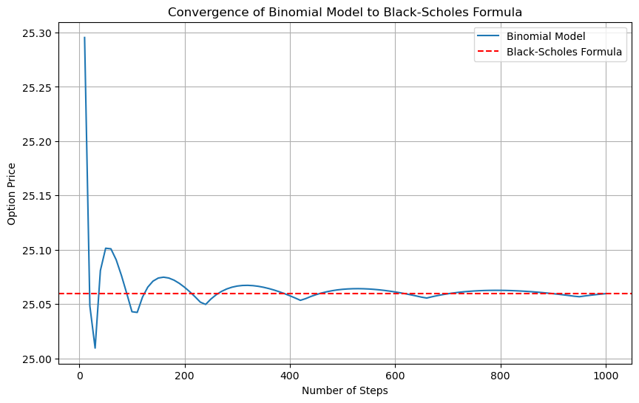
Convergence Analysis: Binomial Model vs. Black-Scholes Formula
The graph visualizing the above
convergence for call option is

Slide 14
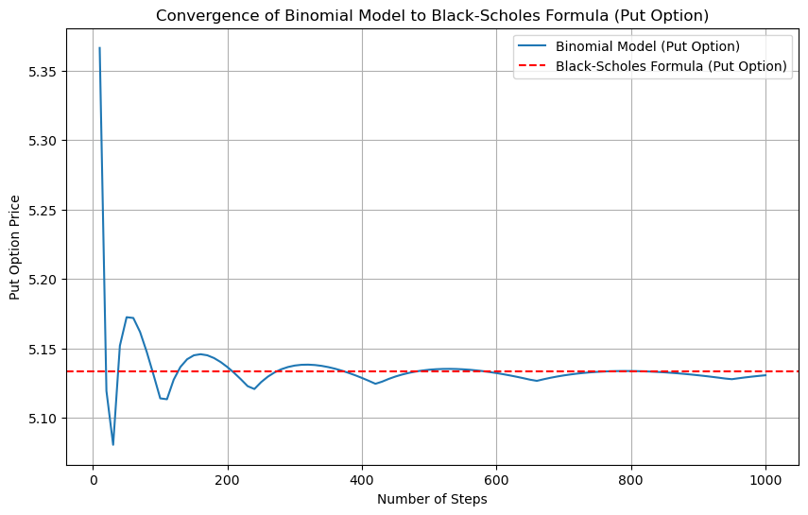
Convergence Analysis: Binomial Model vs. Black-Scholes Formula
The graph visualizing the above convergence for Put option is

Slide 15
Creating a Delta Neutral Portfolio
A delta neutral portfolio is constructed to have a delta value of zero, meaning that changes in the underlying asset's price have minimal impact on the portfolio's overall value.
For A call Option Buy- Selling stock establishes a negative delta position, while buying call options introduces positive delta, aiming to balance the portfolio's overall delta to achieve neutrality.
For call option:
Shares needed for delta-neutral portfolio: -0.7654
Options needed for delta-neutral portfolio: 1
Total delta of the portfolio: 0.0

Slide 16
Creating a Delta Neutral Portfolio
For A Put Option Buy- Buying stock establishes a positive delta position, while buying put options introduces negative delta, aiming to balance the portfolio's overall delta to achieve neutrality.
Shares needed for delta-neutral portfolio (put option): 0.2346
Options needed for delta-neutral portfolio (put option): 1
Total delta of the portfolio (put option): 0.0

Slide 17
Implied Volatility Calculation Using Numerical Methods
The current market price of an option indicates the market's expectation for future
price volatility of the underlying asset, which is measured as implied volatility. Stated
differently, it refers to the implied level of volatility of the option based on its current market
price and other specified parameters.
The Newton-Raphson method, a numerical technique for solving equations iteratively. This method aims to find the volatility parameter that equates the Black-Scholes option pricing formula's output to the observed market price of the option.
l
For call option: Implied Volatility call option: 0.1959
For put option: Implied Volatility put option 0.2003

Slide 18
Understanding Option Greeks: Interpretation and Analysis
The primary Option Greeks
Delta:
For a call option, Delta measures the rate of change of the option price in response to changes in the underlying asset price. A Delta of 0.7654 indicates that for every $1 increase in the underlying asset's price, the option price is expected to increase by approximately $0.7654.
For a put option, Delta measures the rate of change of the option price in response to changes in the underlying asset price, but with a negative sign. A Delta of -0.2346 suggests that for every $1 increase in the underlying asset's price, the option price is expected to decrease by approximately $0.2346.
Gamma:
Gamma measures the rate of change of Delta with respect to changes in the underlying asset price. A Gamma of 0.0091 means that Delta is expected to change by approximately 0.0091 for every $1 change in the underlying asset's price. It quantifies the curvature of the option price curve.
It is observed that effect of Gamma is same for CALL or PUT Options

Slide 19
Understanding Option Greeks: Interpretation and Analysis
Theta:
Theta measures the rate of change of the option price with respect to the passage of time, or time decay. A Theta of -10.1525 for the call option implies that the option price is expected to decrease by approximately $10.1525 per day, all else being equal.
For the put option, a Theta of -3.0796 suggests an expected decrease in price of approximately $3.0796 per day, all else being equal.
Vega:
Vega measures the rate of change of the option price in response to changes in volatility. A Vega of 53.0132 indicates that for every 1% increase in volatility, the option price is expected to increase by approximately $53.0132, all else being equal.
Rho:
Rho measures the rate of change of the option price in response to changes in interest rates. A Rho of 116.9289 for the call option suggests that if interest rates increase by 1%, the option price is expected to increase by approximately $116.9289, all else being equal.
For the put option, a Rho of -35.8320 suggests that if interest rates increase by 1%, the option price is expected to decrease by approximately $35.8320, all else being equal.

Slide 20
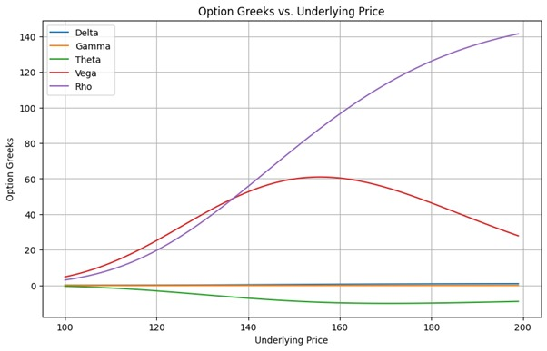
Option Greeks: Visual Analysis
Impact on option Greeks for Call Option

Slide 21
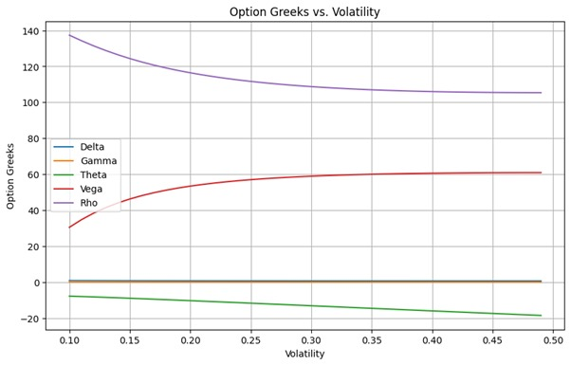
Option Greeks: Visual Analysis

Slide 22
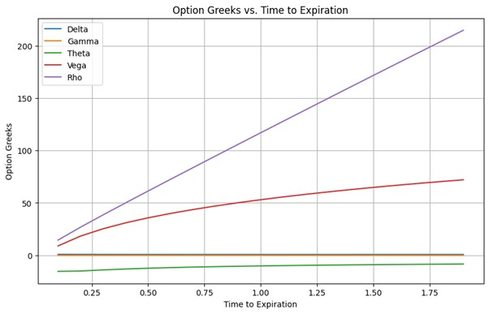
Option Greeks: Visual Analysis

Slide 23
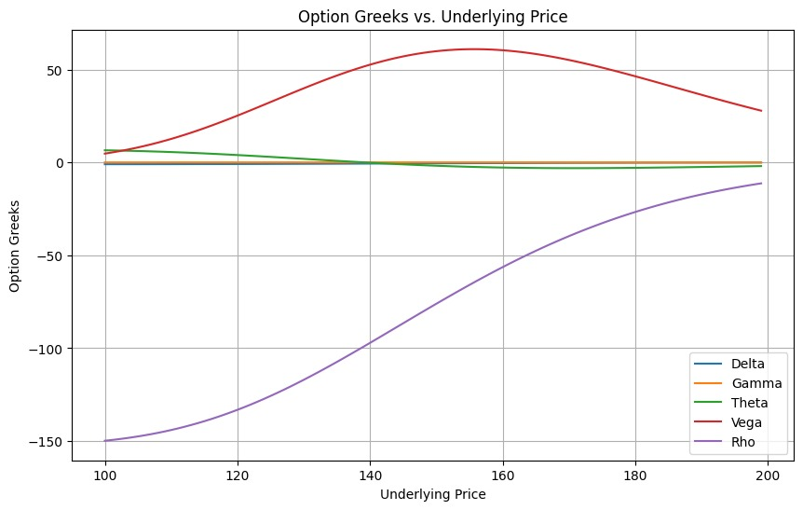
Option Greeks: Visual Analysis
Impact on option Greeks for Put Option

Slide 24
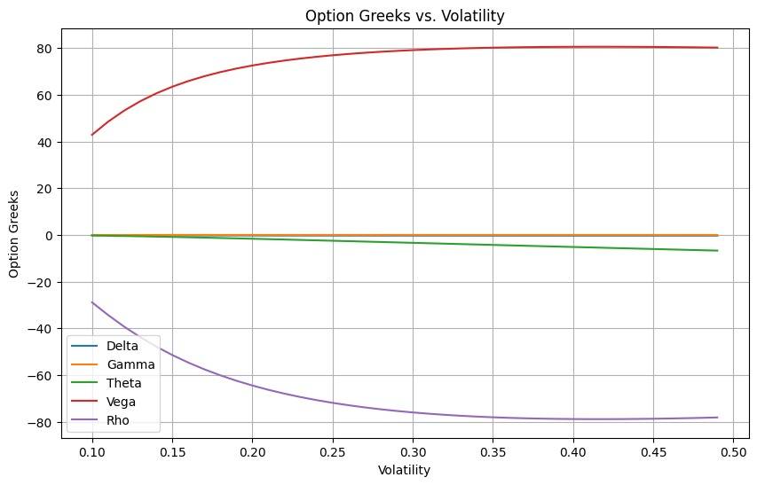
Option Greeks: Visual Analysis

Slide 25
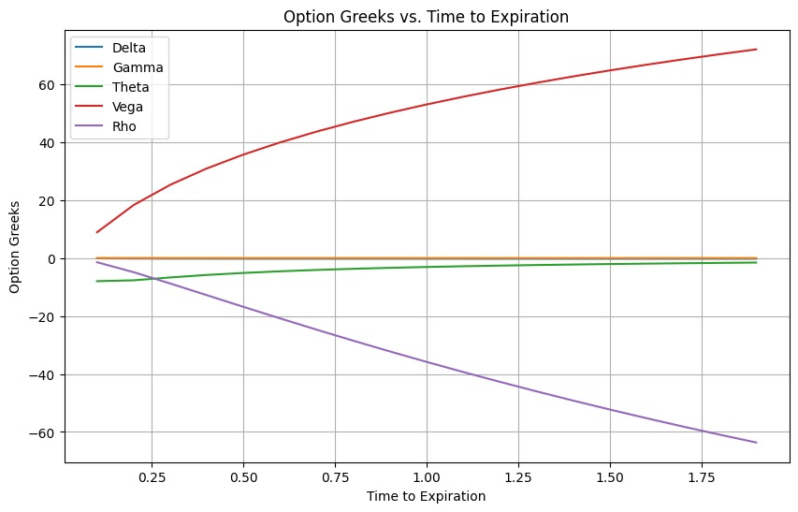
Option Greeks: Visual Analysis

Slide 26
Conclusion
The findings, encompassing implied volatilities hovering around 19.59% for calls and 20.03% for puts.
Alongside option prices derived from diverse models like One-Step Binomial, Black-Scholes Formula, where we find difference in the option prices from both model. As we increase the number of steps to 1000, option prices from both model converges.
Delta-neutral portfolios, with deltas close to 0.7654 for calls and -0.2346 for puts, highlight effective risk-mitigating strategies. Additionally, insights from the Greeks—delta, gamma, theta, vega, and rho—illuminate option sensitivity to underlying asset price shifts, time decay, implied volatility alterations, and interest rate fluctuations.

Slide 27
Thank you for your time🙂

